Slide 1


ADVERTISING EDUCATION
HOW-TO GUIDE

Slide 2
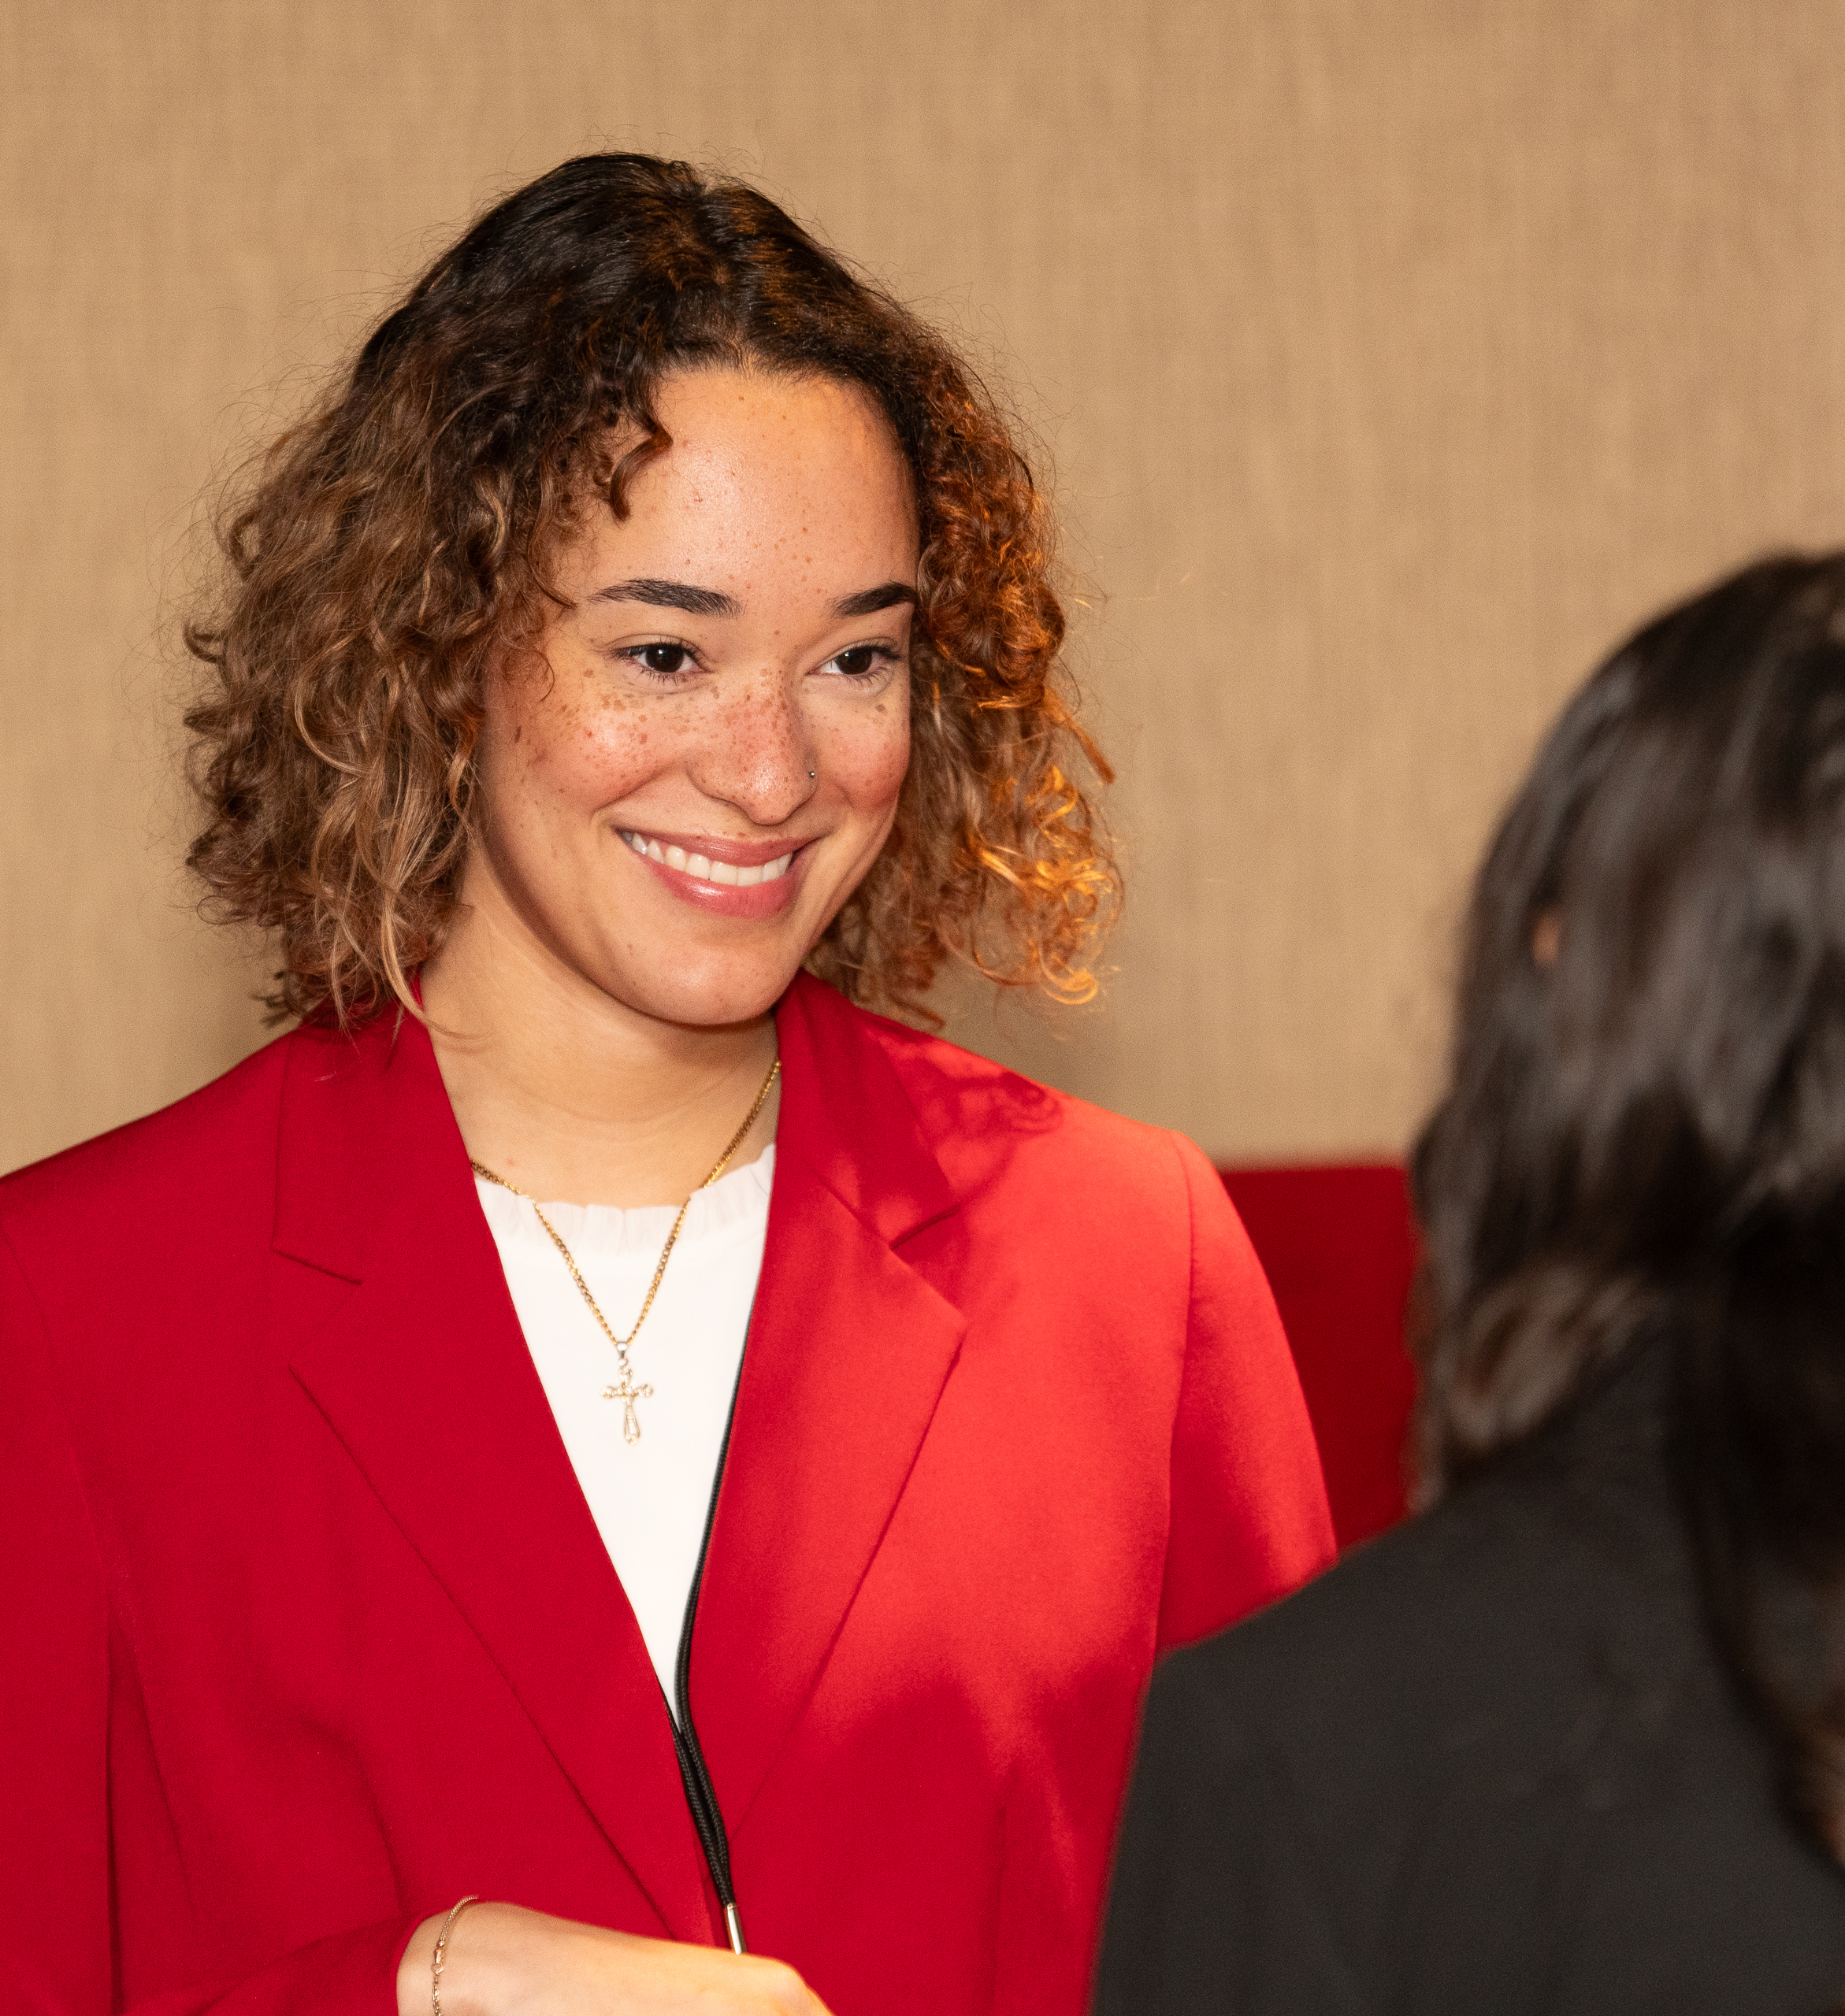
ADVERTISING EDUCATION
To fulfill an AAF priority objective of advancing and improving advertising education and, consequently, positively affecting the future of our industry, AAF chapters should provide students, professionals, and the public with social value of advertising as well as a respect for high industry standards. Educational projects are vital to the health of local advertising chapters.

Slide 3

ADVERTISING EDUCATION
Highly motivational in nature, these projects will increase membership participation and enthusiasm. The opportunity for a broad and positive impact on industry growth and progress is one of many benefits advertising education provides.

Slide 4
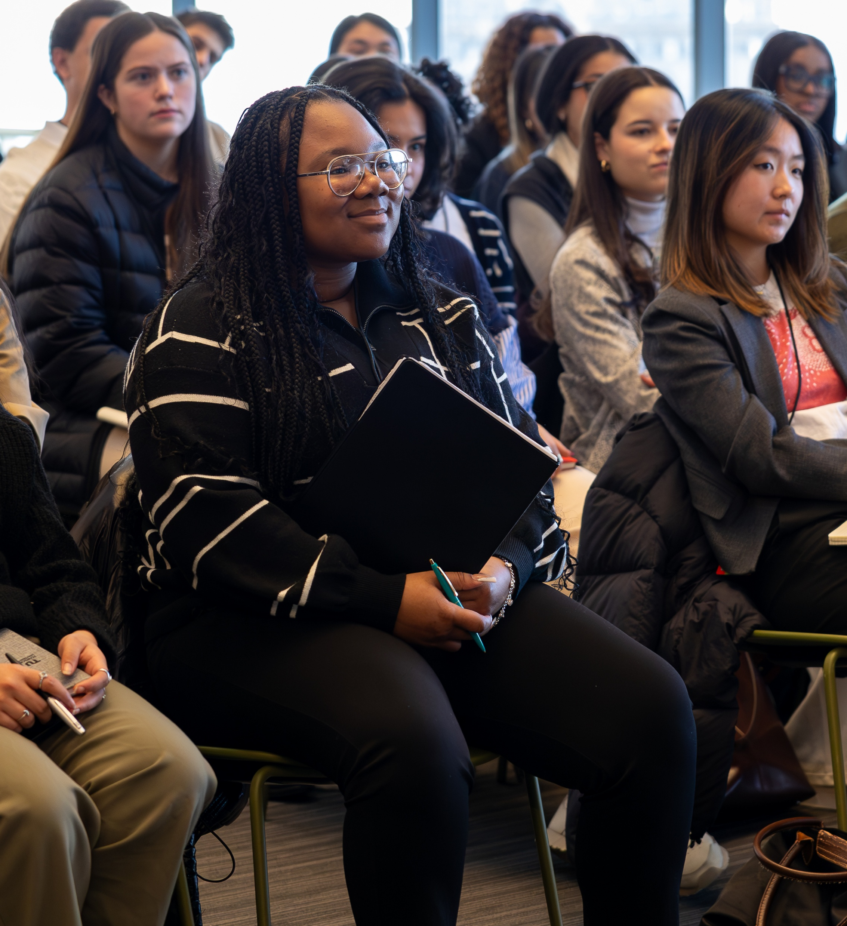
ADVERTISING EDUCATION
This guide has been developed to assist education committee members in planning and conducting projects. Regardless of the level of current chapter activity in advertising education, this guide provides important information on specific programs and offers creative approaches to making standard chapter projects educational in nature.

Slide 5



KEY STAKEHOLDERS
Advertising education concentrates on three areas: students, the public, and professionals. While student programs are distinct, most other activities (including chapter initiatives) often overlap to serve multiple audiences.
PROFESSIONALS
Any program or event that aids the practitioner’s knowledge of any aspect of the advertising business.
STUDENTS
It is important to note that students can be classified into both public and professional audiences. Consequently, the best approach is to include this group in all advertising education projects, in addition to as many regular chapter events and programs as possible. Naturally, chapter education activity will sometimes be geared strictly to students. This is appropriate and vital. Example: Student Agency Tour or Portfolio Review Day
PUBLIC
Any program or event that aids the public’s awareness, understanding and positive perception of advertising and its economic and social value. These projects do not have to be targeted to the public exclusively.

Slide 6
GETTING STARTED

Slide 7
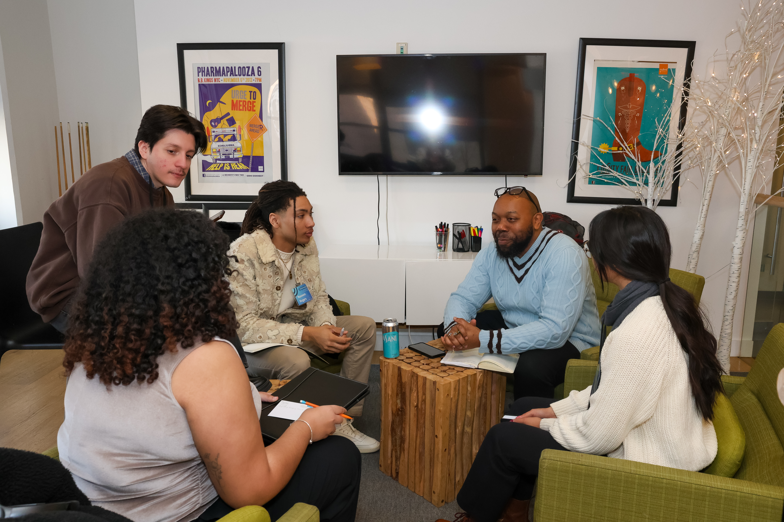
COMMITTEE FORMATION
Successful advertising education requires a dedicated committee and a phased approach. To prevent burnout and ensure continuity, chapters should launch one project at a time, adding others annually as resources grow.
By dividing tasks into subcommittees for students, the public, and professionals, the chairperson can distribute the workload effectively. This structured strategy fosters a sustainable leadership pipeline while maintaining a high standard for all chapter initiatives.
The president ensures success by selecting viable projects and recruiting a committed team.
A clear leadership structure supports the expansion of educational efforts while preventing individual burnout.

Slide 8
COMMITTEE RESPONSIBILITIES
FINANCING
Funding is a critical consideration for ongoing projects. Chapters must evaluate available monetary resources before committing to specific educational activities.
Suggested ways to finance:
Charge admission fees
Secure sponsorships
Fundraising
Member donations
PUBLIC RELATIONS
Beyond altruism, education projects offer significant public relations value. Chapters should assign PR responsibilities to a committee member or the chapter Communications Chair during the planning phase. Highlighting these programs strengthens overall promotion and projects a positive community image.

Slide 9
EDUCATIONAL
OPPORTUNITIES
IN ALL CHAPTER ACTIVITY

Slide 10
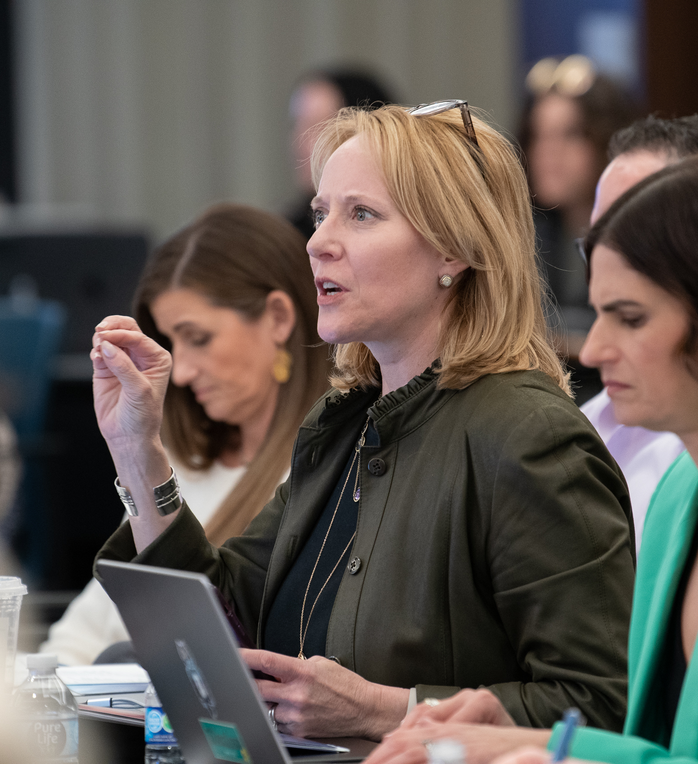
EDUCATIONAL OPPORTUNITIES
An important objective of this guide is to encourage chapters to think about advertising education and explore educational possibilities in all chapter activity. Many of the projects and events that chapters regularly conduct are educational in nature. However, in planning, most chapters do not take this approach. Consequently, opportunities in advertising education are overlooked.

Slide 11
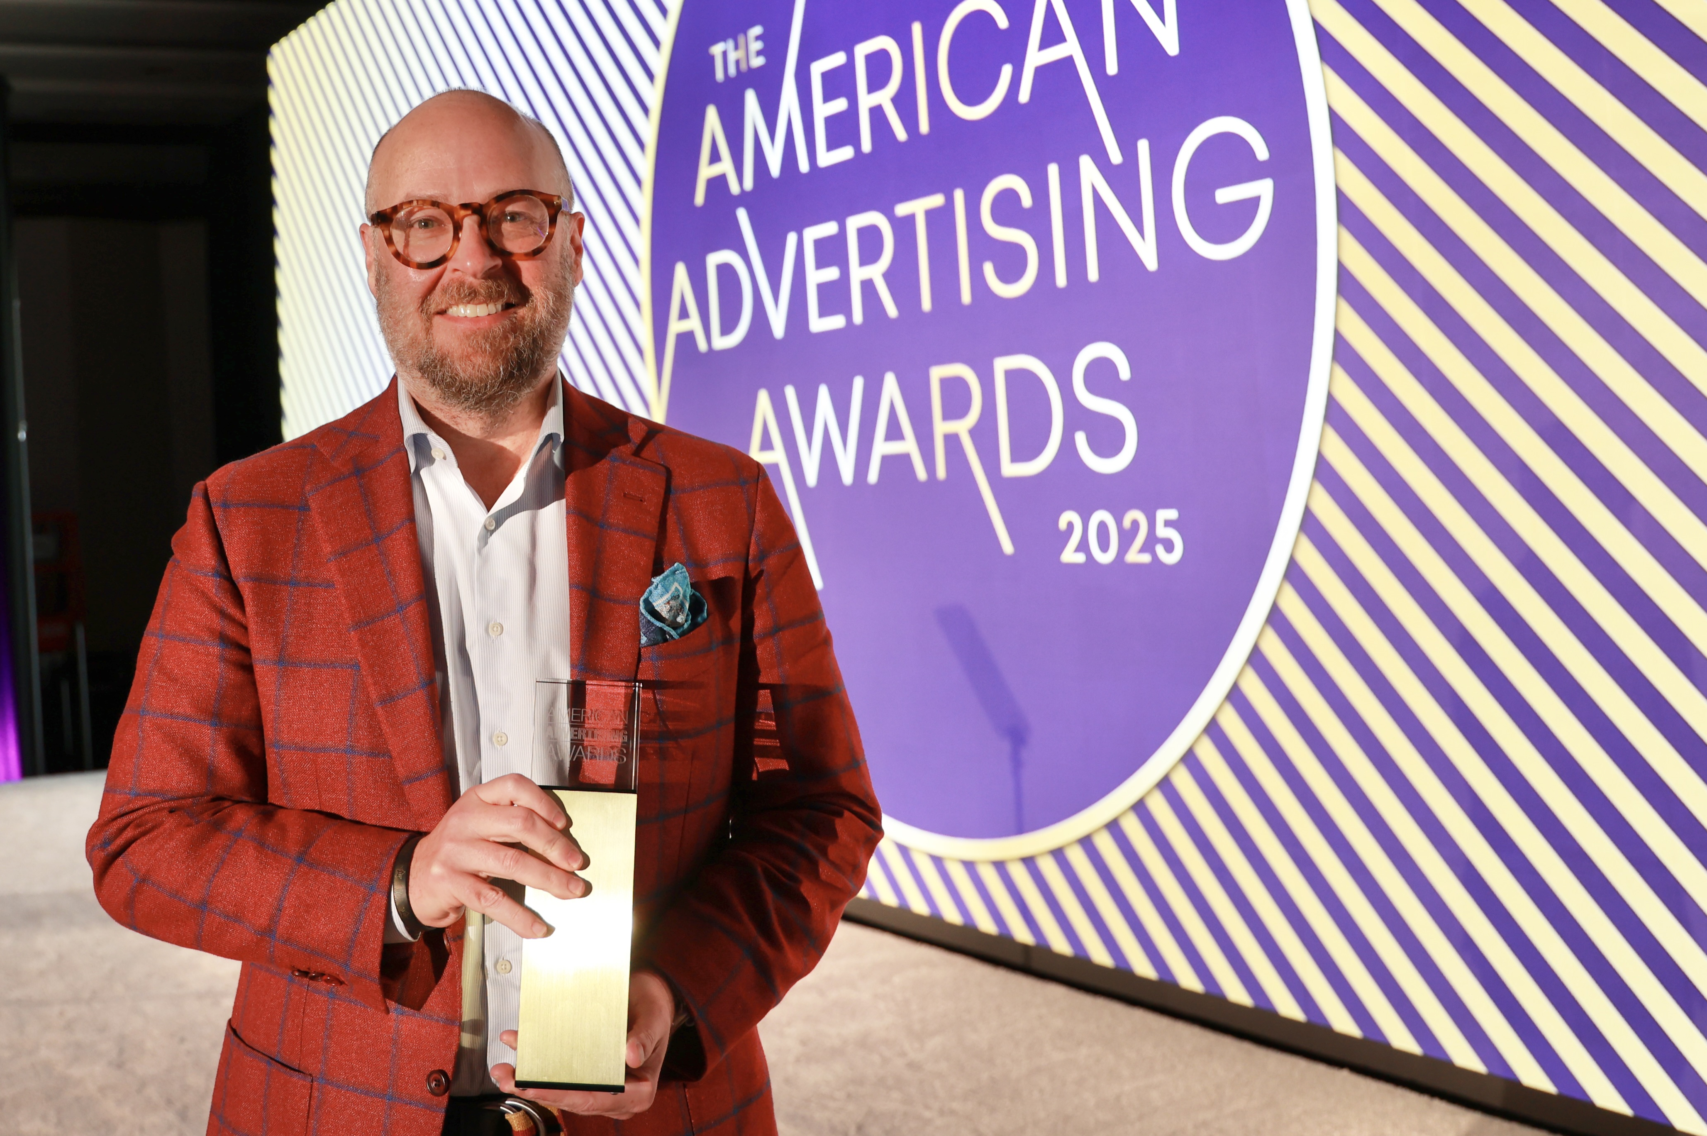
AMERICAN ADVERTISING AWARDS
The American Advertising Awards are an excellent advertising education program. This chapter event is not typically considered in terms of its educational value and instead is approached as a fundraiser or social event. The American Advertising Awards, however, are an ideal opportunity to educate the public and the profession about the value of advertising standards while also keeping the audience entertained.
Educational Opportunities:
Invite the public
Invite local educators (HS/College)
Invite area students
Donate entries to students/schools

Slide 12

GENERAL MEETINGS
General membership meetings are vital educational programs focused on professional growth. Members attend to hear industry leaders discuss timely topics and to strengthen professional networks. Because many employers fund these memberships, chapters must ensure speakers provide relevant perspectives benefiting both the individual and their business.
To maximize value, leadership should provide speakers with chapter demographics to help them tailor their presentations. Promotion should clearly link the topic to the interests of various membership segments, reinforcing the professional importance of attending.

Slide 13
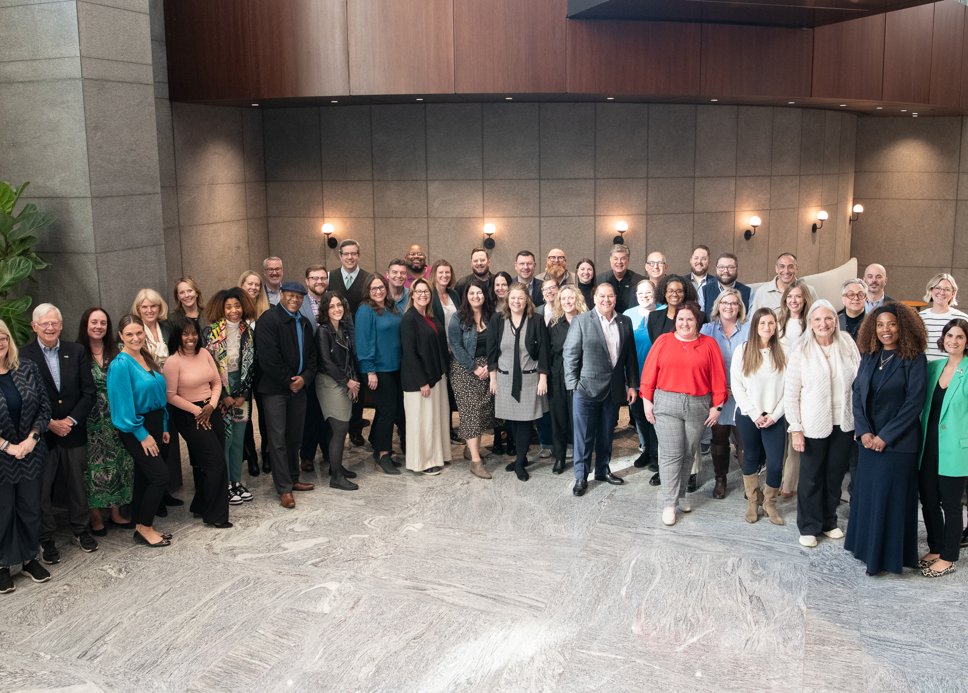
GENERAL MEETINGS
Maximize speaker value by hosting receptions for networking and industry discussion. This creates opportunities for professional growth and potential chapter sponsorships.
Visit the AAF’s Speakers Bureau to find the right speaker for your next event.

Slide 14
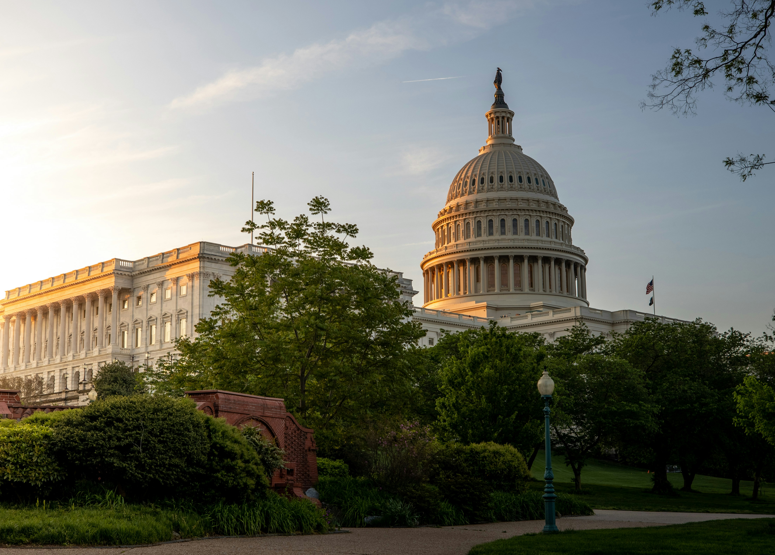
GOVERNMENT RELATIONS
Effective government relations require educating the public and legislators on the economic and social value of advertising. These programs should remain active even when regulatory threats appear remote, emphasizing the industry's role in public information. Chapters should utilize AAF National’s economic impact studies for their specific state or congressional district to support these efforts.

Slide 15
ADVERTISING EDUCATION PROGRAMS

Slide 16
NATIONAL STUDENT ADVERTISING COMPETITION (NSAC)
The AAF National Student Advertising Competition (NSAC) is a premier, educational program where college chapters develop comprehensive advertising campaigns for a national brand. While competition rules strictly prohibit professionals from providing direct assistance on student projects, local chapters can play a vital role by providing travel grants or funding for district and national competitions.
Chapters can also volunteer to host the district-level competition, which involves securing judges, managing the venue, and coordinating logistics. This involvement is mutually beneficial, as it allows professionals to review student plan books for fresh marketing insights, observe modern presentation techniques, and network with industry judges.
Learn more about the National Student Advertising Competition

Slide 17
STUDENT INTERNSHIPS
Internships provide future professionals with vital hands-on experience, but success requires a long-term commitment to maintain credibility with schools and employers. Chapters should establish clear scheduling (whether full-time summer roles or part-time school-year positions) based on employer preference and faculty input. Securing advance agreements from participating companies and maintaining a deep pool of student applicants are essential for effective screening and matching.
Funding models vary, with some chapters splitting costs with employers for transportation or lodging, so these expenses must be integrated into the budget. To ensure the program's quality, chapters should implement a comprehensive evaluation system for both interns and employers. Regular joint meetings can serve as an effective tool for monitoring progress and identifying areas for improvement.
Chapters are also encouraged to introduce their students to the AAF’s Campus to Corporate Talent Program.
Learn more about the Campus to Corporate Talent Program

Slide 18
STUDENT SCHOLARSHIPS
Although there is obviously a financial commitment, scholarships programs are easily executed.
Key elements in establishing a scholarship are:
Funding: Chapters must have a reliable source. Scholarships can be budgeted item with money raised from chapter activated allocated to a scholarship fund, or corporate sponsorship can be solicited.
Applicant Pool: A sufficient base of qualified and deserving applicants must be available. Contacts at area schools with related degrees are important.
Time: Sufficient time to secure the maximum number of qualified applicants, implement a screening process and plan promotion/publicity.
Committee: A qualified screening committee and established criteria are necessary. The committee should include academic and advertising professionals, on a non-conflict basis.
Scholarship Name: Naming the scholarship for a well-respected local advertising leader contributes to increased awareness and understanding about the scholarship.
Consider an American Advertising Awards Student Best of Show scholarship.
Learn more about the various AAF Student Resources

Slide 19
SHADOW PROGRAMS
This project refers to arranging for local high school and/or college students to “shadow” an advertising professional during business hours. Shadow programs provide students with the opportunity to develop an understanding of specific aspects of the advertising business and determine specific areas of career interest.
Key elements in developing a shadow program are:
Identify Students: Interested area school(s).
Identify Professionals: Willing advertising professionals.
Funding: Transportation and expenses. (Lunch should be covered by either the advertising professional or the chapter.)
Reporting: A system of reporting student attendance to the school and a feedback mechanism to monitor the value of the program to students (e.g., a verbal or written report).
Learn more about the various AAF Student Resources

Slide 20
CAREER DAYS
The objective of a career day is to give interested students the opportunity to become aware of specific careers in advertising, guide them into academic study, extra-curricular activity, or work options that will assist them in achieving their career objective, and put them in contact with professionals. Advertising businesses look upon career days as recruiting opportunities. This project can be in conjunction with a school’s career day or separately.
Key elements in conducting a career day are:
Identifying Professionals: A sufficient number of participating professionals to speak to the students about various advertising-related careers (e.g., agency, advertiser, media, supplier representatives, etc.).
Venue: A large facility with proper A/V equipment, which is accessible to both students and professionals.
Promotion: Develop a publicity plan to ensure a sufficient student audience to make the event worthwhile and contribute to repeat participation by professionals.
Career Days, continued >>>

Slide 21
CAREER DAYS
Planning: Knowledge of area schools’ schedules to avoid conflicts that would adversely affect attendance.
Funding: The event should break even. Some chapters charge an admission fee to student/business recruiters attending. This fee should cover costs; however, they must be kept low for students or attendance will suffer. Student attendance must adequate to draw professionals and recruiters. Printing and facility donations help keep costs down.
Learn more about the various AAF Student Resources

Slide 22
AAF NATIONAL SPEAKERS BUREAU
The AAF National Speakers Bureau connects your chapter with industry leaders across every advertising discipline. Whether you are planning a keynote, technical workshop, or panel, our resource provides access to experts ready to share their knowledge.
Learn more about the AAF National Speakers Bureau.

Slide 23
SHIRTSLEEVE SEMINARS
Designed as in-depth reviews of specific advertising topics, shirtsleeve seminars are detailed and narrow in subject matter.
Consequently, these seminars will not appeal to the general membership and chapters should target specific members in related fields. However, be sure your entire membership is informed because many may want to broaden their own professional growth.
Key steps to conducting successful shirtsleeve seminars are:
Structure: Assign each seminar to a member with relevant expertise who can act as a coordinator or speaker.
Schedule: Avoid over-scheduling, as these specialized sessions have a narrower appeal than general meetings.
Venue: Select venues based on expected attendance. Consider using TV stations, radio stations, or agencies for smaller groups.
Shirtsleeve Seminars, continued >>>

Slide 24
SHIRTSLEEVE SEMINARS
Fees: Set registration fees to cover all costs. Member rates should be lower than non-member rates and excluded from standard dues.
Participants: Define the target demographic by age and career level before setting prices to ensure the event remains accessible.
Promotion: Use both general and targeted outreach. Always coordinate with the speaker before launching specialized promotional materials.
Learn more about the various AAF Educator Resources

Slide 25
“PONY EXPRESS” SEMINARS
The "Pony Express" seminar follows a product or service from concept to market, similar to a rider collecting parts of an order along a route. These seminars function as comprehensive case histories, covering every developmental phase: product research, testing, design, pricing, packaging, distribution, market planning, and advertising.
Key steps in conducting a pony express seminar are:
Scheduling: Allow at least a full day to do this in-depth type of seminar.
Participants: Include both advertiser and agency representatives in the seminar presentation so that all contingencies are covered.
Content: Assure the case study is of broad appeal to draw a sufficient audience and facilitate interaction.
Funding: Fees should be charged to underwrite expenses, including lunch for participants.
Venue: Coordinate facility arrangements with presenter needs and ensure luncheon facilities are available.
Promotion: Publicize to the entire membership, in addition to other specific publics with interests related to the case study. College/university faculty and students should be invited to these seminars.
Learn more about the various AAF Educator Resources

